Slide 1
Project Objective:
Recommending a weekly price change schedule for highest Gross Margin Profit
TSC Pricing Optimisation
TEAM : Mind_Benders
Team Members : Divya Upadhyay, Harshita Saxena, Parul Bansal

Slide 2
Overview
Tractor Supply provides an existing price change schedule. Yet there exists an opportunity to increase gross margin profits by recommending optimal prices given constraints on sales using Machine Learning
Problem Understanding
Approach
Recommendation
Both Demand and Price is dynamic and depend on each other. Very high price will reduce the sales and very low price will reduce the gross profit.
Our solution provides instances where changes in prices could have improved profit margins for TSC
Obtain a relationship between demand, price and time.
Forecast sales
Optimise price with respect to forecast
Recommend Weekly price based on forecasted sales for 12 weeks

Slide 3
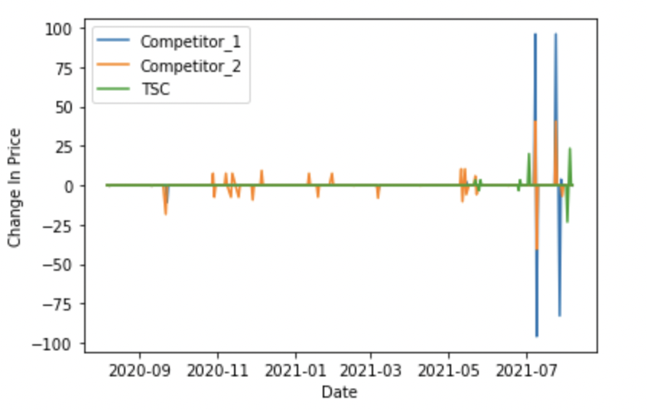
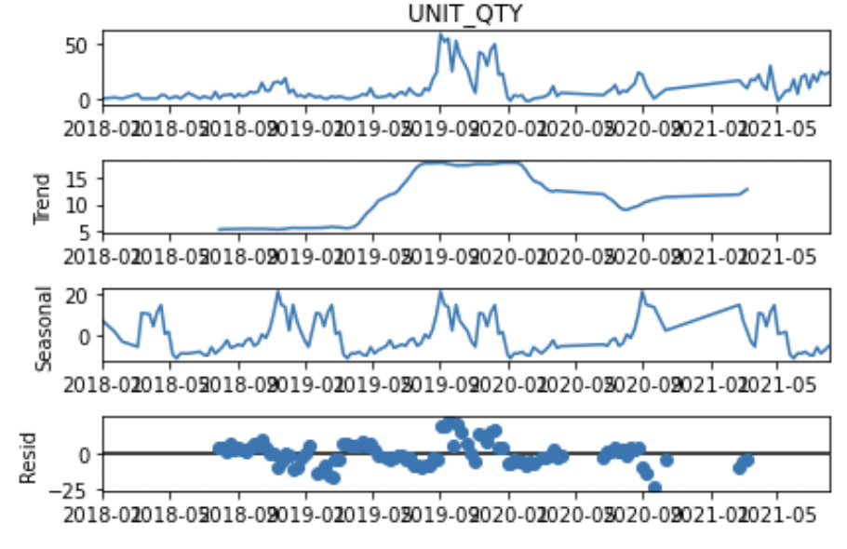
Assumptions and Observations
Assumptions :
Cost price is assumed to be constant.
Minimum Sales Price = 1.33 * Cost_Price for each SKU a) Margin is calculated for year 2021. For each SKU we have taken the min(Unit_Price) and min(Cost_Price). b) Margin is then Calculated as mean(100* (Unit_Price- Cost_Price)/Cost_Price)
Observations :
Negligible Correlation between Competitor price change and TSC price change ;Max Pearson Correlation at SKU level is -0.07.
Some SKU’s have a seasonal nature in months of October, November, December. The sales suddenly increase in month of October November, December.
Price Change Plot for SKU with Maximum Correlation
Spikes in Seasonal Graph shows Seasonality of Demand

Slide 4
Our Approach
STEP 1
STEP 2
STEP 3
STEP 4
Demand-Price Equation :
Estimate an equation between Demand and Price for each SKU at weekly level
Sales Forecast :
Forecast Demand for each SKU at weekly level using historical Demand data using Deep Learning
Optimization:
Find Upper and lower limits of demand at weekly level
Find Optimal Price at weekly level, given Demand-Price Equation, and bounds on Demand forecast and Price.
Results:
Bin the Optimal Price for each SKU’s. For the consecutive weeks, where the bin price is changing, provide optimum price
Notes:
Price 196 198 >= 190 - 195
Tell them a schedule -> 5$
Price start date price end date price

Slide 5
Demand Price Equation: Deep Dive
The Demand- Price equation
Fit Level : a) SKU Level fit : 97 SKU’s b) Duration :2018 - 2021 c) Weekly fit
Model Used: Multi Linear regression
Dependent variable: Unit Qty
Independent Variables: a) Unit Price, Time: year ,month,week, b) Seasonality (Fourier): sin365, cos365 Sin365 : sin(2*pi*day_of_year/52), Cos 365 : cos(2*pi*day_of_year/52) c) Interaction Features: Unit Price*month,Unit Price*year, month*week, month*year, month*year*week, month*year*Unit Price
Accuracy Metrics
Metric | Value
Sales Weighted R Squared | 0.42
Sales Weighted adjusted R squared | 0.34
*Weights are calculated using Unit_Qty sold
32 items have a R-squared >0.5
Equation estimated:
Unit_qty = const + a*Unit Price + b*year +c*month +d*week+ e*sin365+f*cos365+ g*Unit Price*month+h*Unit Price*year+ i*month*week+j*month*year+k*month*year*week+l*month*year*week*Unit Price

Slide 6
Demand Forecast : Process
Demand = Trend + Seasonal + Error
Step 1: Extract weekly Trend, Seasonality from Demand at SKU level.
Step 2: Forecast Weekly Demand Trend at SKU level for 12 weeks using Deep Learning Model.
Step 3: Final Demand at weekly level : Forecast Trend + Seasonal Demand
Scrub Item 24: Split Uit_Qty : Trend, Seasonal, Error

Slide 7
Demand Forecasting : Deep Dive
Demand Forecast Overview
Dependent Variable : Sales Trend
Forecast Duration: 12 weeks
Model Used : Temporal Fusion Transformer
Train Duration : 2018- 2021
Fit Level : a) Global Fit: Single Forecasting Model for all SKU’s b) Weekly fit
Independent variables : a) Scrub Item,
b) Year, Week Number, Time Index c) Seasonality (Fourier): sin365: sin(2*pi*day_of_year/52, cos365:Cos 365 : cos(2*pi*day_of_year/52)
Notes:
Overview -> model use kiya and how to do results look
Sales = trend + seasonality

Slide 8
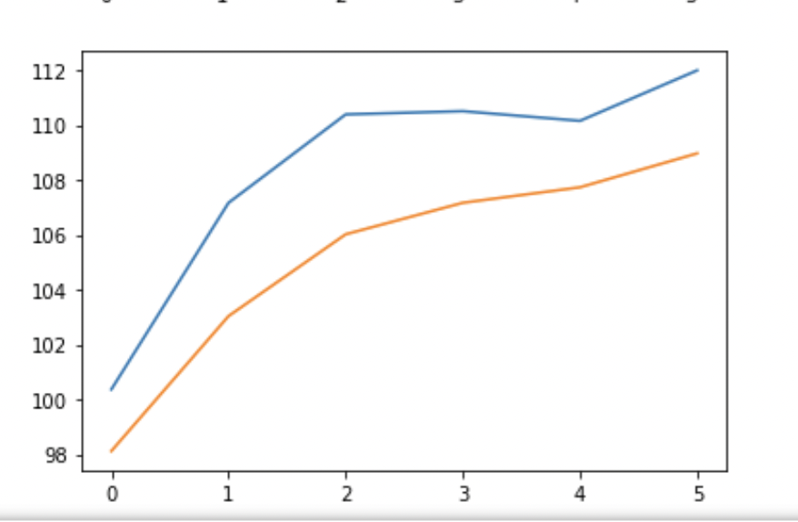
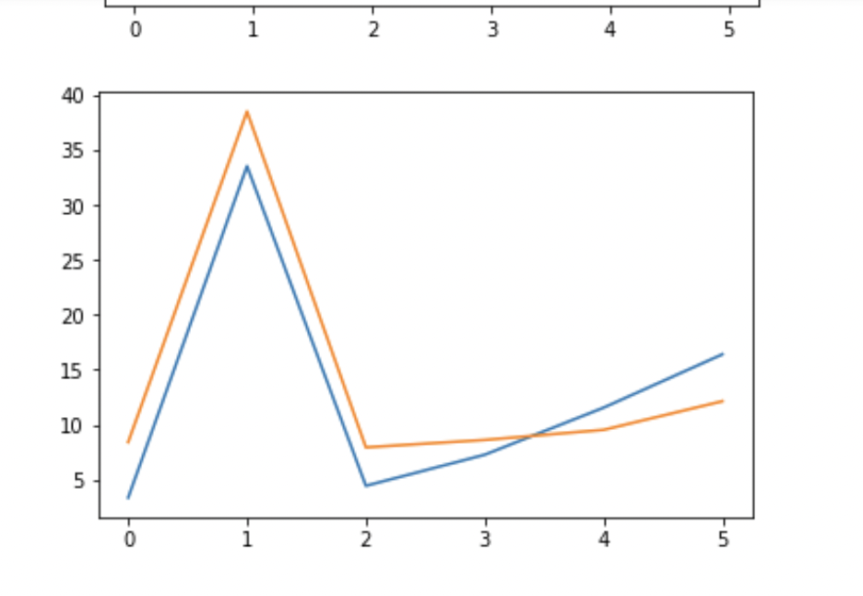
Forecasting Model : Deep Dive
Temporal Fusion Transformer
Deep Learning Forecasting Model for multi-horizon forecasting , ie builds a single model for similar SKU’s
Accuracy MAPE :5% (6 weeks in future)
Can be easily extended to other SKU’s
Able to learn dependencies between different SKU’s, and also time dependencies for the same SKU
Number of Timesteps in Future
Actual
Predicted
Demand Trend
Number of Timesteps in Future
Demand Trend
Number of Timesteps in Future

Slide 9
Optimisation : Deep Dive
Technique used : Sequential Least Squares Programming (SLSQP)
Objective Function: Maximize Gross Profit Margin
Constraints :
1) Upper and Lower Bound for Demand(Qty) : (1 ± MAPE)*Demand Forecast
Lower Bound = 0.8*Demand Forecast, Upper Bound : 1.2*Demand Forecast
2) Upper and Lower Bound for Price : Lower bound = Margin* cost_price : 1.33 *cost_price, Upper bound= Max Unit Price
3) Equality Relationship between Demand, Unit Price and Time : Demand Price equation Fit
Final equations : Maximum Gross Profit and Sales
Recommendation for price change schedule : Based on the above algorithm, we can get the prices and forecast for each week or each month. Now using the variation in price change data, we bin prices in sizes of 5$ : 100-105, 105-110 , 110-115 etc. The Start date and End date is then suggested if the price range changes.

Slide 10
Optimisation : Deep Dive
Input variables / parameters
Sales Forecast
Relation b/w. sales and price – fit line
Constraints
Sales Range - (1 ± MAPE)*Demand Forecast
Price Range – (Margin* cost_price, Max. of Unit_price)
Objective function
Minimizing gross margin profit to arrive at optimal price for each item at weekly level
Applying heuristic (Sequential Linear Squares Programming - SLSQP) to find optimal price having sales values obtained from sales forecast
Results
Recommend price change of each item in a week
Creating a bin of $5 and if price value of continuously week arriving in some bin then merge that rows into one and then calculate price start date & end date accordingly

Slide 11
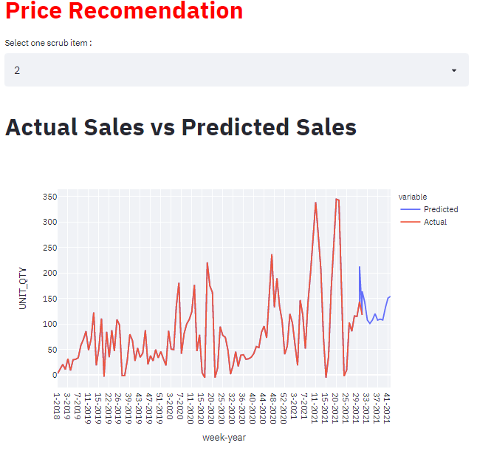
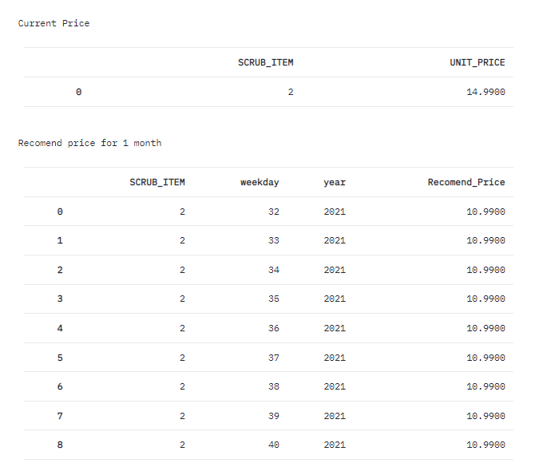
User Interface

Slide 12
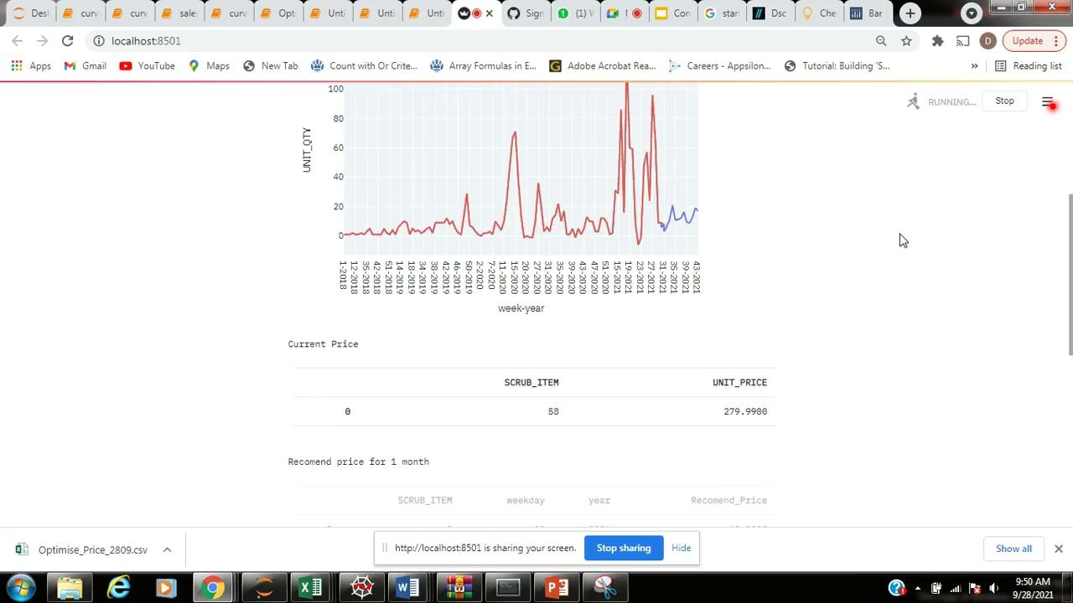
UI – Reference Video

Slide 13
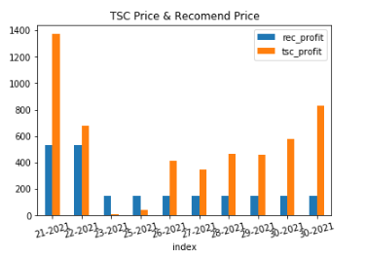
Result
Scrub Item 1
In week 23 Recommended profit is higher than existing price
Opportunity for improvement – If we have better demand price relation, optimization will be better as forecast is very accurate with respect to the trend
Corresponding graph is just for 1 random item
Graph
# for which avg profit is higher
# Possible profit gain
Notes:
Actual sales -> price optimisation -> price, sales -> gross profit for 6 weeks , tsc gross profit for 6 weeks

